Slide 1
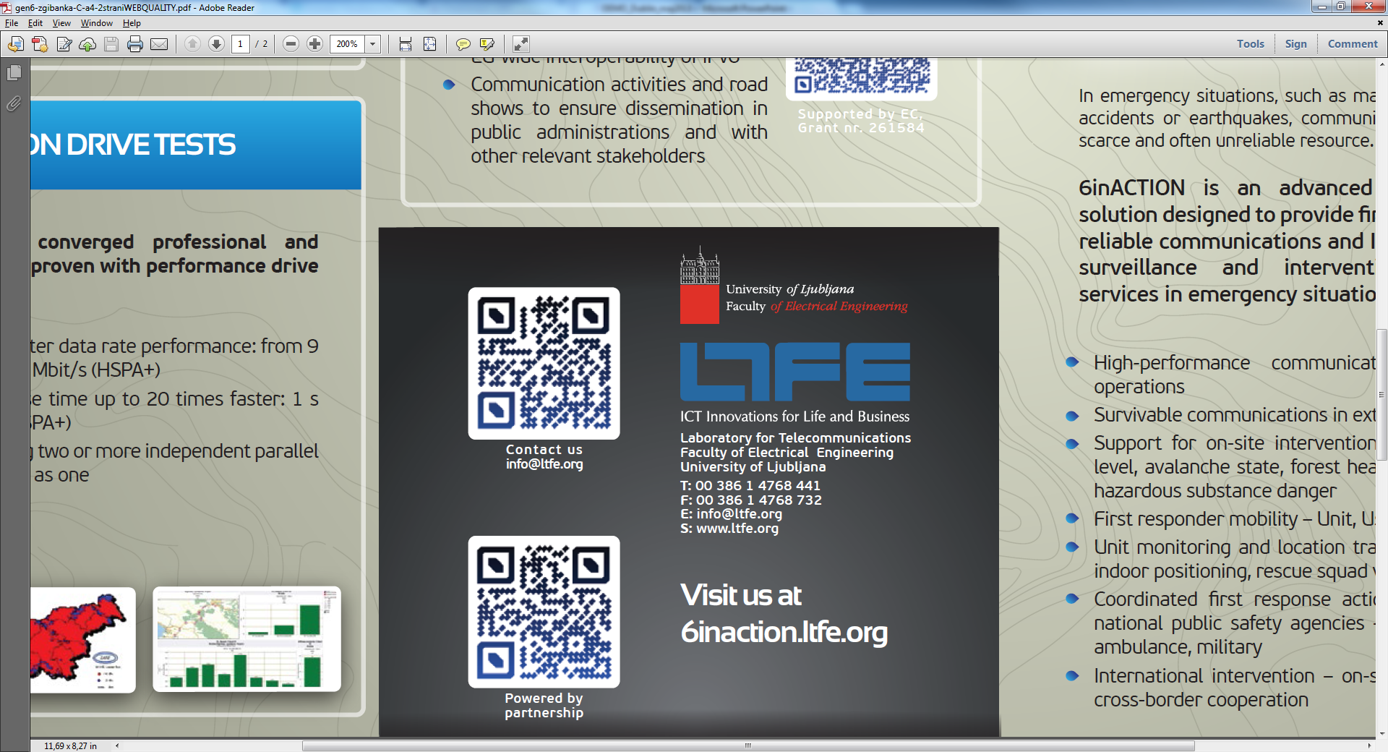
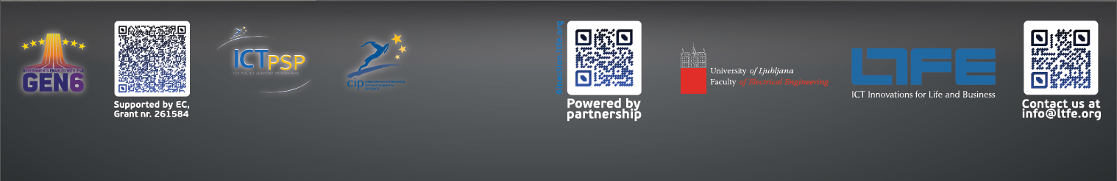
Der IPv6-Kongress, Frankfurt/Main Mai 2014
6inACTION – Smart Communications Solution in Emergency Situations
Janez Sterle, Universität Ljubljana, Slowenien
janez.sterle@fe.uni-lj.si

Slide 2


GEN6 – Governments ENabled with IPv6
Project time frame
1.1.2012 – 1.12.2014
19 EU partners
7 national pilots
2 cross-border pilots
EC reference
http://ec.europa.eu/information_society/apps/projects/factsheet/index.cfm?project_ref=297239
http://www.gen6-project.eu/
Slovenian pilot – A-ERCS
Advanced Emergency Response Communication Solution
http://www.gen6-project.eu/A-ERCS.html
A-ERCS System deployment name 6inACTION
http://6inaction.net/

Slide 3
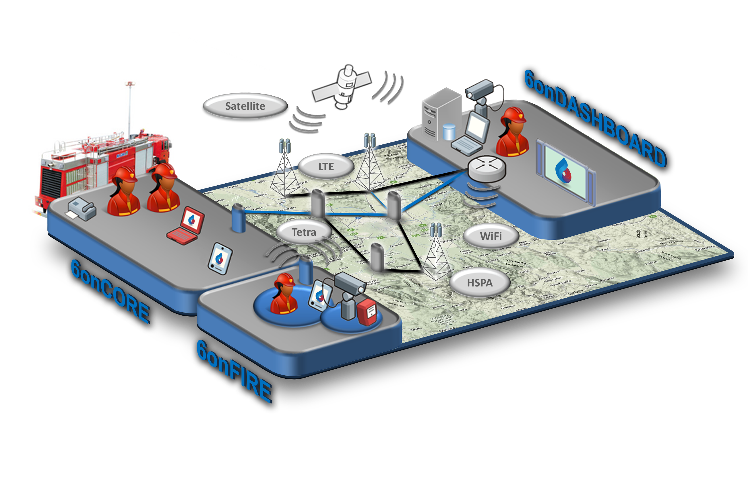
Smart and compact mobile solution designed to provide first responders with reliable communications and IoT-driven situation surveillance and intervention management services in emergency situations
6onCORE
DISTRIBUTED AND ROBUST OVERLAY NETWORK
6onDASHBOARD
IoT-DRIVEN INTERVENTION MANAGEMENT
6onFIRE
ON-SITE SENSOR SYSTEM
6onMOBILE
TRIAGE APPLICATION
Notes:
So, what is the story behind the 6inACTION?
Todays professional end commercial communication systems are build, managed and provisioned as vertical separated wall gardened siloes. State od the art professional technology is TETRA(EU) or P25(USA). TETRA system is optimized for voice communications, with optional data rate of up to 9kbps – system speed. In tetra you have special features like direct mobile-to-mobile cal, p2t, group calls etc.
On the other hand state of the arte commercial mobile solution in operations is LTE, which is ALL IP packet system capable of transfering multimedia reach communication with the speed of up to 80 or 100Mbps.
If you compare state of the art technologies in the field of profesional and commercial communication system there is at least gap of 2, 3 or even 4 generations. TETRA is first generation of GSM EDGE.

Slide 4
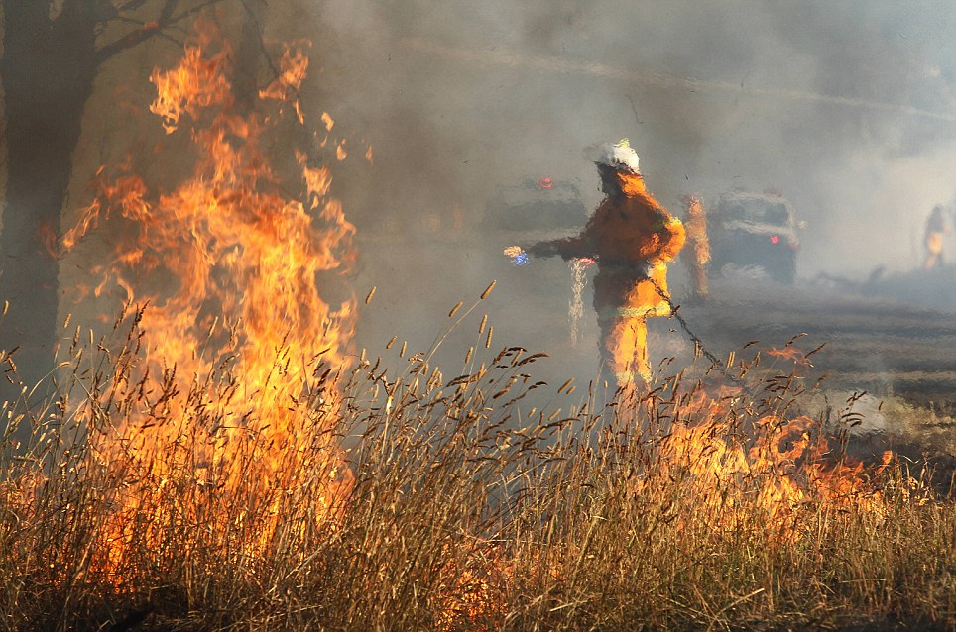
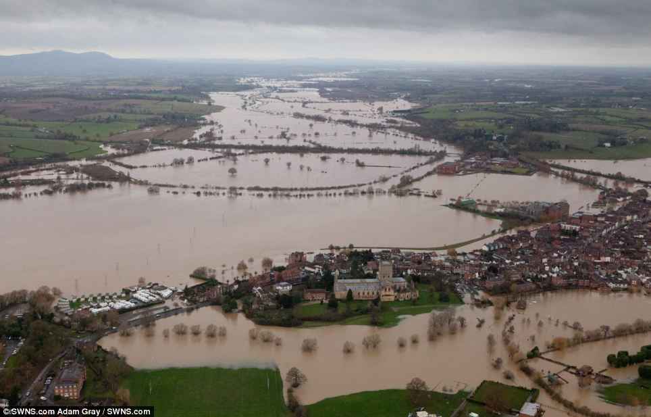
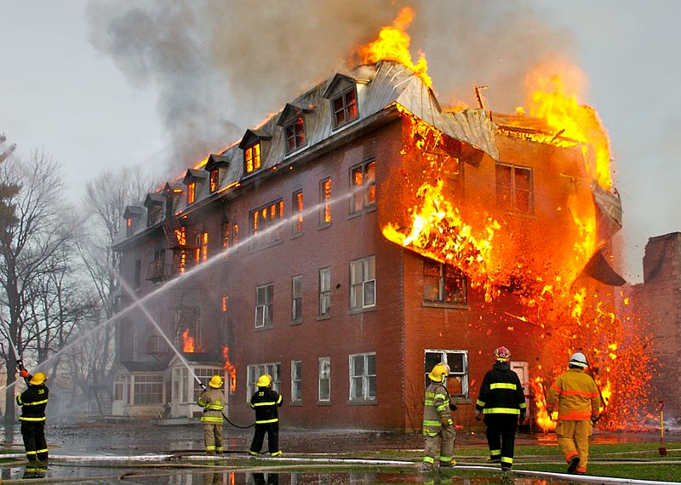
Every day operations
Fire
Flood
Water rescue
Car accidents
…
Source: Dalymail
Source: Dalymail
Source: Wikipedia
Professional and commercial communication systems are 100% operational

Slide 5

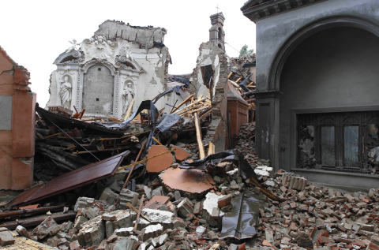
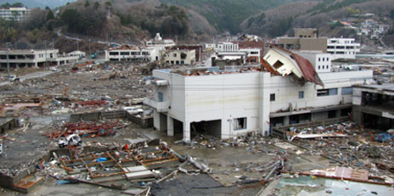
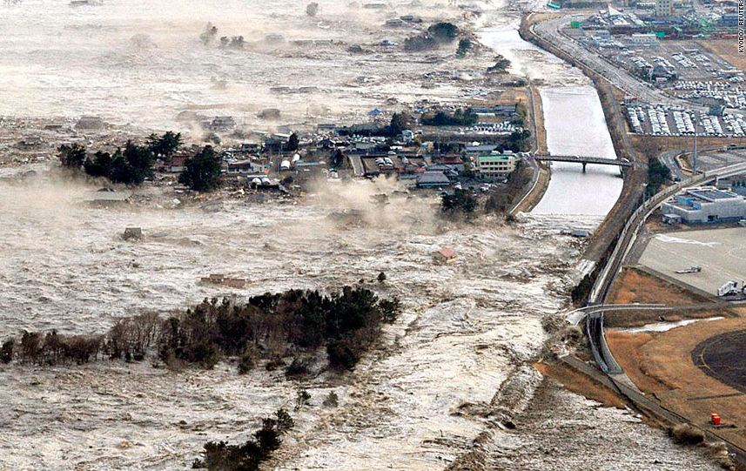
Extreme natural disasters
Earthquake in Italy (2012)
Earthquake&Tsunami in Japan (2011)
Hurrican Katrina (2005)
Source: CBS
Source: A. Kwasinski
Source: Kimberly K.
Professional and commercial communication systems are down!

Slide 6
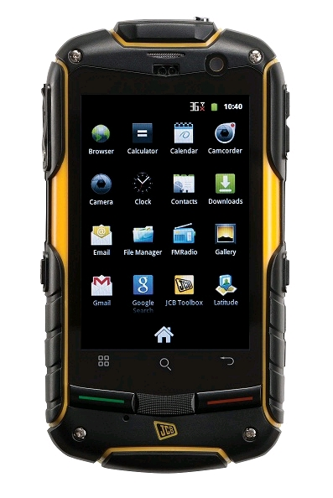
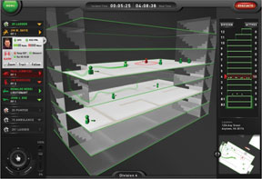
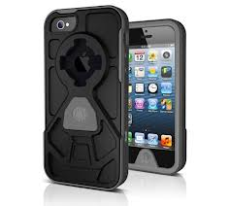

Different requirements for different scenarios!
High-performance communications in day-to-day operations
Survivable communications in extreme conditions
Distributed system and service intelligence
Support for on-site intervention monitoring
Water level, avalanche tracking, forest heatmap, hazardous substance
Firs responders mobility
Unit, user, device, sensor
Unit monitoring and location tracking
GPS location, indoor positioning, rescue squad vital signs
Coordinated actions across different national public safety agencies
Fire fighters, police, ambulance, military
International intervention
On-site and cross-border cooperation

Slide 7
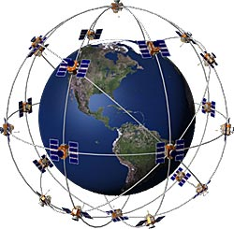
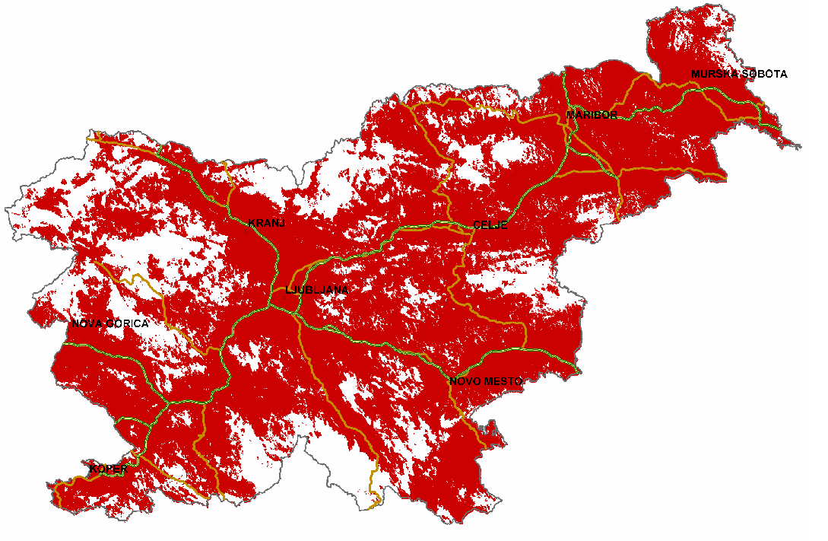
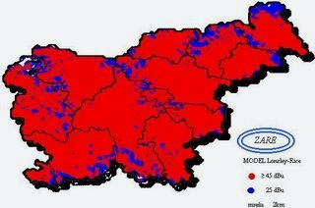
6inACTION Vision
Converged communications in emergency situations
a distributed and robust overlay communication solution for data transport and rich multimedia service built across professional (e.g. DMR, TETRA, Satellite) and commercial networks (e.g. UMTS/HSPA, LTE)
Satellite Communications
Coverage
Commercial Operator
HSPA/LTE Coverage
Professional System
DMR/TETRA Coverage
High Availability
High Performance
Ruggedized Terminals
IPv6 convergence layer and smart network enabler

Slide 8
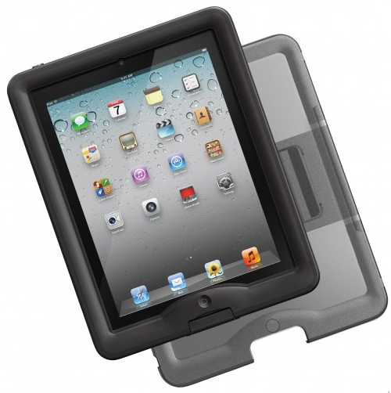
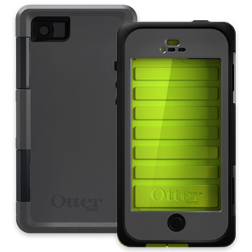
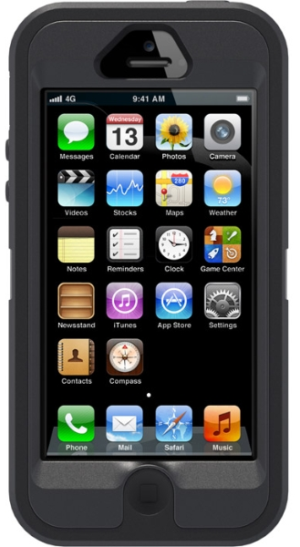
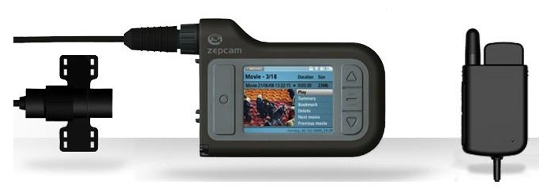
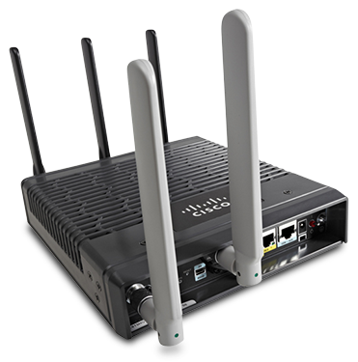
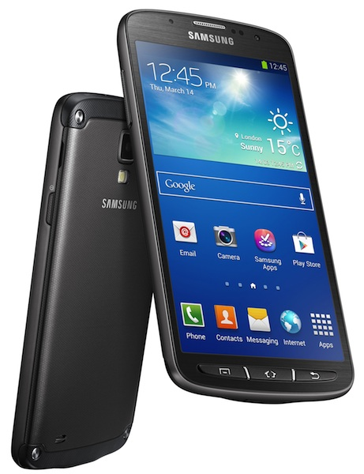
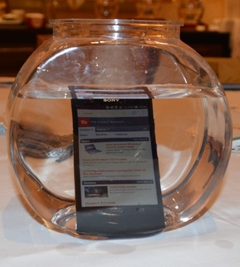
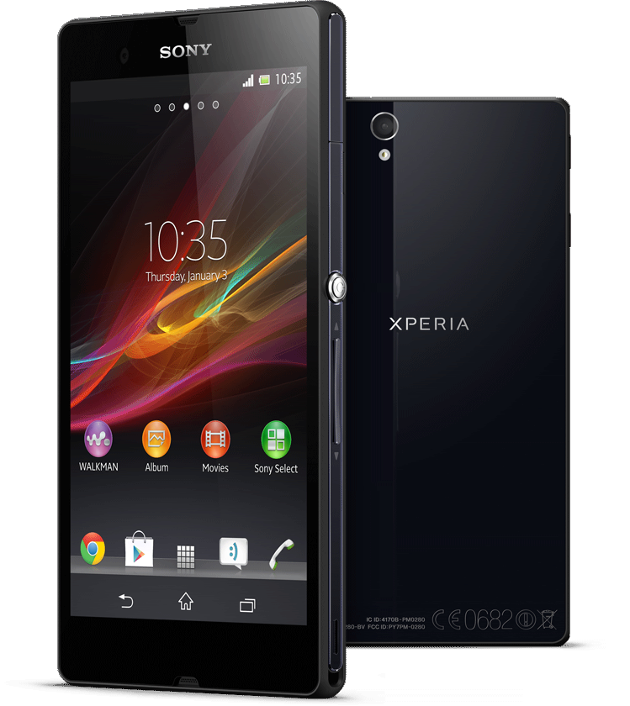
6inACTION Vision – Technology
COTS terminals and equipment
IP67, Mil, Water Proof, Crush Proof, Drop Proof, Dust Proof,

Slide 9
Public Safety Regulation and Standardization

Slide 10
Regulation and standardization
BB PPDR – BB Public Protection and Disaster Relief
ITU-T - Report ITU-R M.2033
Radiocommunication objectives and requirements for public protection and disaster relief
US FCC mandates LTE for public safety network (Februar 2012)
700 MHz, D Block
„President Barack Obama yesterday signed into law the payroll-tax-cut extension legislation, which reallocates the 700 MHz D Block spectrum to public safety and provides $7 billion in federal funding to help pay for the buildout of a nationwide LTE network for first responders.“
http://urgentcomm.com/policy_and_law/news/obama-signs-dblock-law-20120223
Congressional Research Service
Substantial radio coverage is targeted, and the act instructs leveraging existing infrastructure by establishing agreements to use commercial or other communications infrastructure already in place. (e.g., federal, state, tribal,)
EU Regulation - CEPT ECC Report 199 (May 2013)
User requirements and spectrum needs for future European broadband PPDR systems (Wide Area Networks)
Frequency blocks
400MHz, 700 MHz, 2GHz?
Defined operational environments/category for BB PPDR
PP1: Day-to-day operations
PP2: Large emergency and/or public events
DR: Disaster Relief
Standardization - 3GPP Release 12
http://www.3gpp.org/Public-Safety

Slide 11
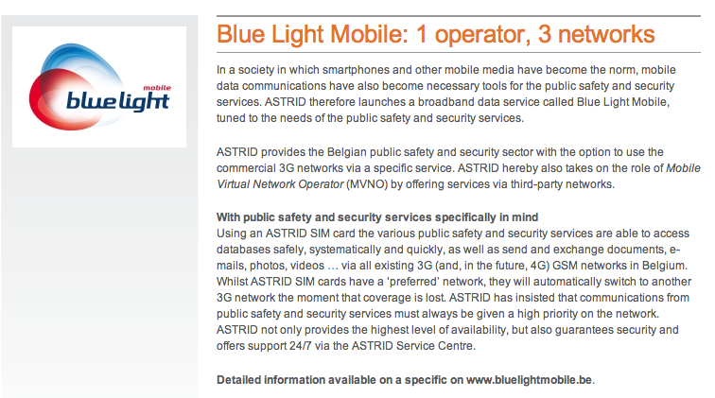
EU – 3G and LTE in Public Safety environment
ASTRID Belgium – Public safety MVNO operator
http://www.astrid.be

Slide 12
6inACTION
First BB PPDR System by „CEPT ECC Report 199“

Slide 13
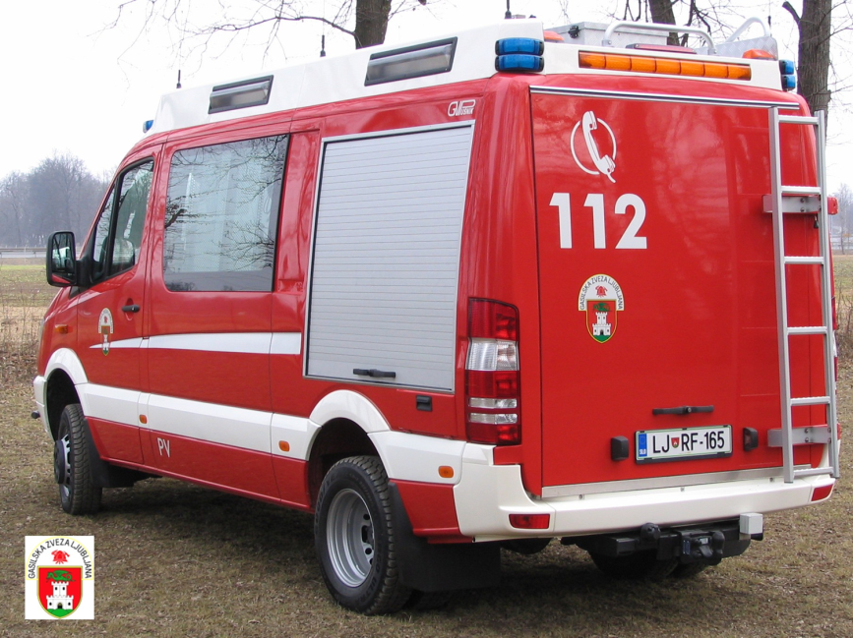
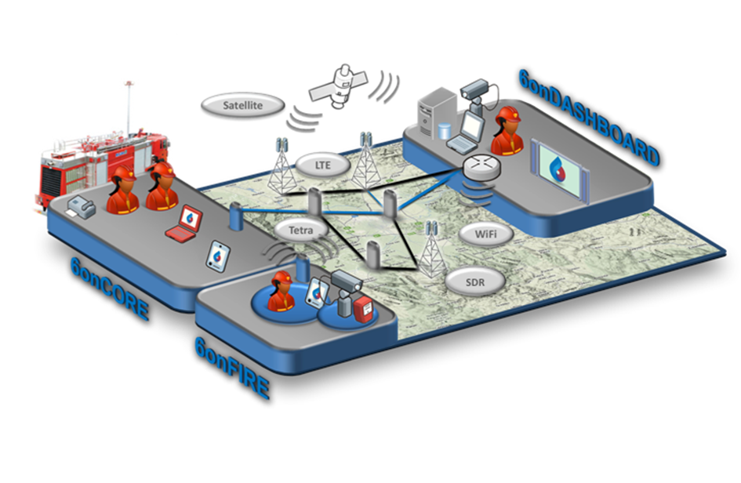
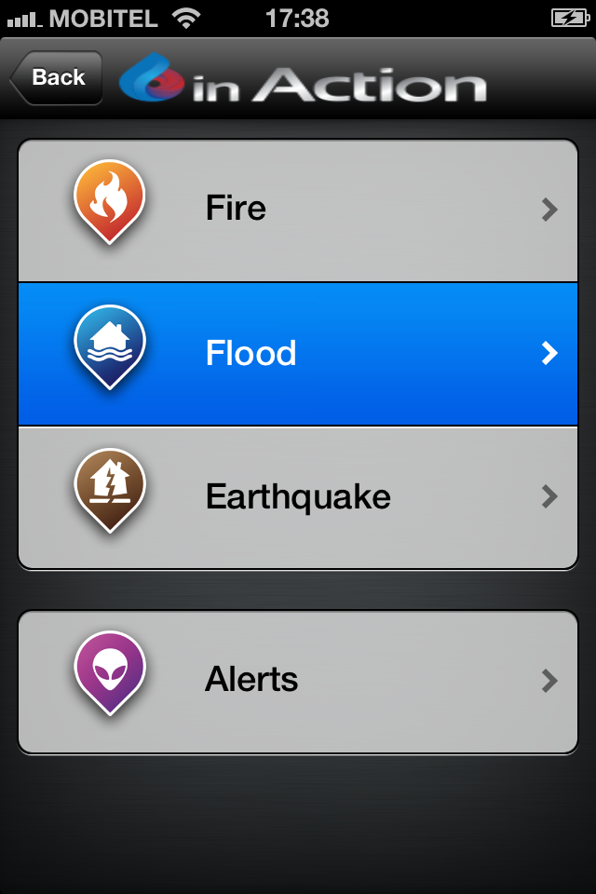
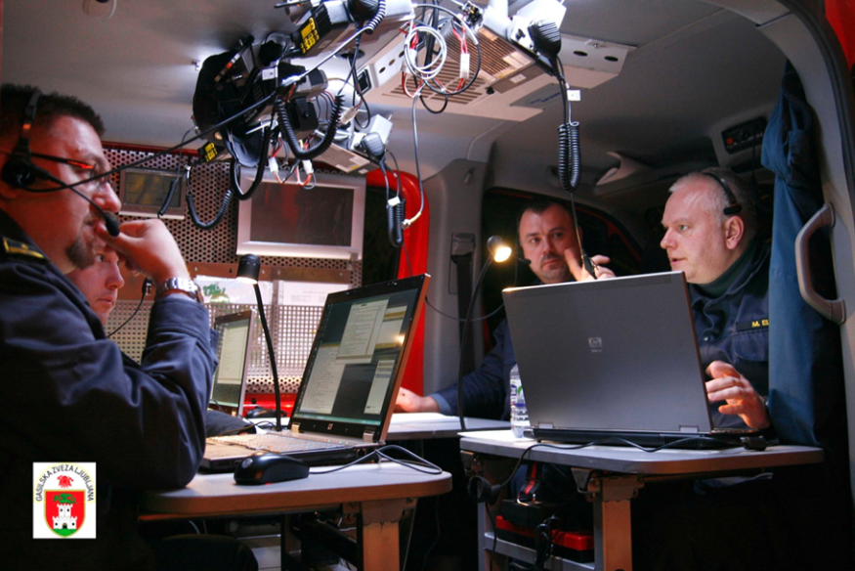
SYSTEM TODAY
Backhaul
DMR
Telco UMTS/HSPA
On-site
DMR radio
SERVICES TODAY
Voice – 1. priority
Messages – 2. priority
SYSTEM TOMORROW
Backhaul
DMR, TETRA, satellite
Telco UMTS/HSPA, LTE, WiFi
xDSL/FTTH
On-site
DMR radio, WiFi mesh, sensors
SERVICES TOMORROW
Voice – 1. priority
Messages – 2. priority
Pictures – 3. priority
File – 4. priority
Video – 5. priority
Sensor & M2M services
6onMOBILE
IPv6, NEMO, PMIPv6, DSMIPv6 IPSec, …

Slide 14
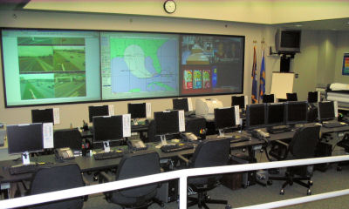

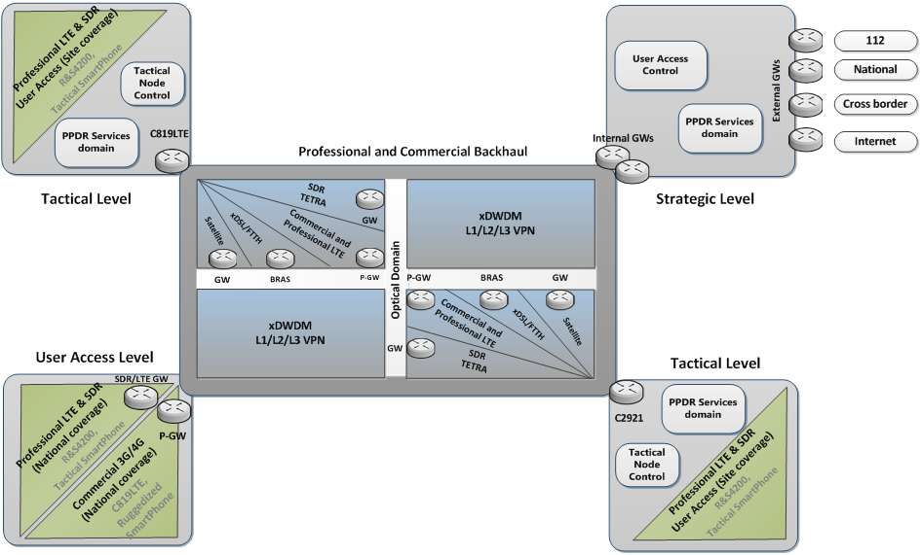
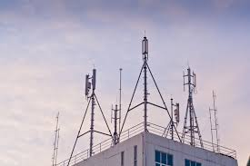
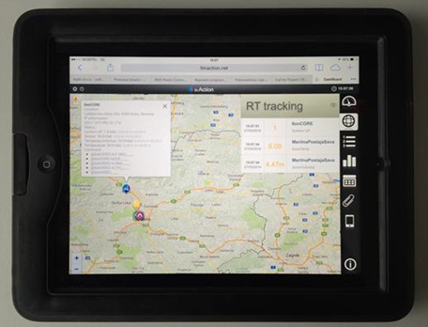
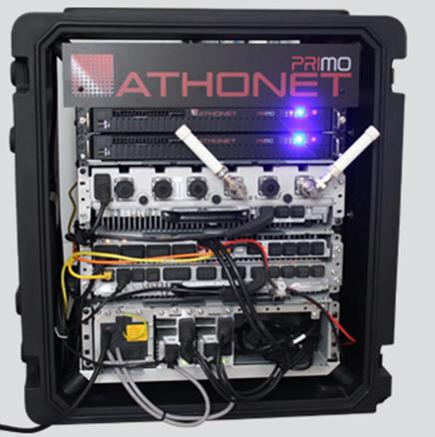
6inACTION System – High level system architecture
IPv6, NEMO, DSMIPv6, IPSec, …
TACTICAL LEVEL
STRATEGIC LEVEL
USER/MISSION LEVEL
TACTICAL LEVEL

Slide 15
6inACTION Deployment Architecture @ Telekom Slovenije

Slide 16
Mobile node/user provisioning – private APN
AAA and security process
Phase 1.: LTE/UMTS AKA – mobile provider
USIM Authentication and Key Agreement in HSS/HLR server
Phase 2.: Extended node/user authentication and authorization – 6inACTION system
CHAP/PAP in Radius server
Phase 3.: Additional encryption for the most critical services – 6inACTION system
IPSec for networking devices (6onCORE)
SSL VPN for end user devices (6onMOBILE)
DSMIPv6 for sensor gateway (6onFIRE)
Network parameter assignment
RADIUS assigned and P-GW/GGSN enforced IPv4&IPv6 parameters - 6inACTION system
LTE option
IPv6 EPS bearer
IPv4 EPS bearer
IPv4/IPv6 EPS bearer
HSPA/EDGE option
IPv6 PDP context
IPv4 PDP context
SSL/TLS VPN option
IPv4/IPv6
IPv6
IPv4

Slide 17
6inACTION System – Detailed deployment architecture (mobile part)
Step 1.: EPS/UMTS AKA
Step 2.: PAP/CHAP@Radius
Step 3.: SSL VPN/IPSec (optional)

Slide 18
6inACTION – Architecture for Cross-border Operations over 3G/4G
SLOVENIA
CROSS-BORDER
NATION
International
GRX/IPX
Tested IPv4/IPv6 Germany
Austria
Lithuania
Greece
Portugal
☑
☑
☑
☑
☑

Slide 19
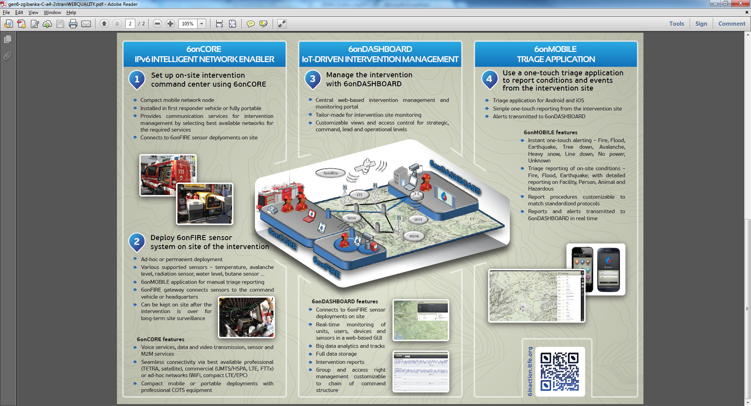
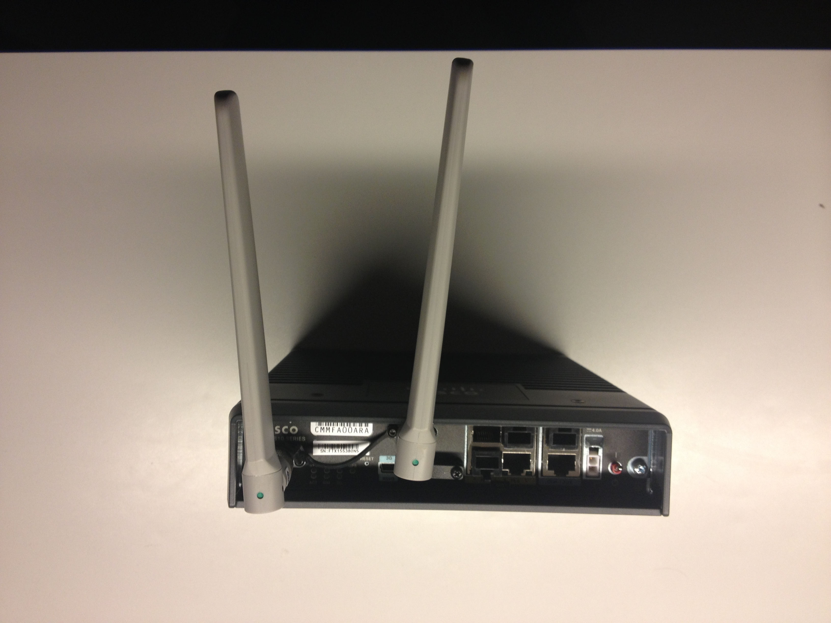
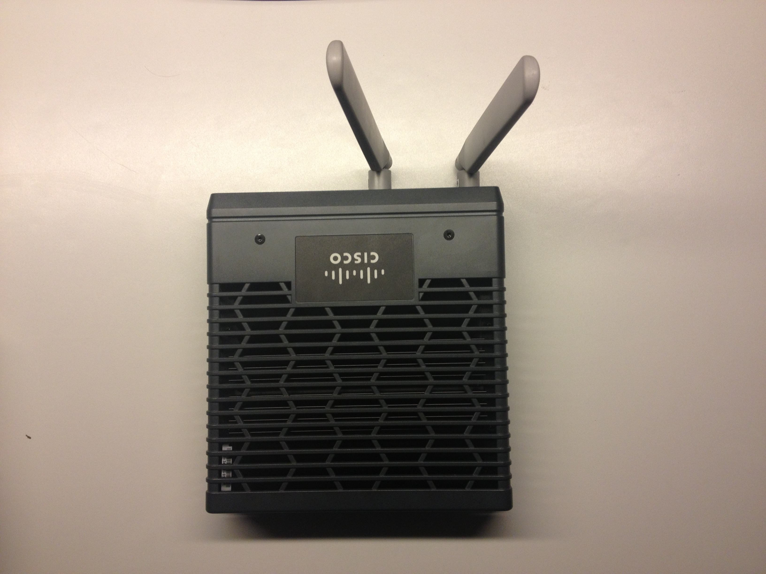
IPv6 network intelligence
NEMO with MCoA and IPSec
secure and transparent 6onCORE node mobility
SLAAC and DHCPv6
host and network nodes auto configuration
Multicast with MLD, PIM-SM and scope options support
flexible live multimedia streaming on-site and globally
IPv6 hierarchical addressing
fast unit, user and sensor provisioning
BGP and OSPFv3
PA addressing
IPv6 PA and IPv4 PA addressing
IPv6, NEMO, PMIPv6, IPSec, …
Technical design
Cisco ISR819 M2M router

Slide 20
Tactical Smart Devices

Slide 21
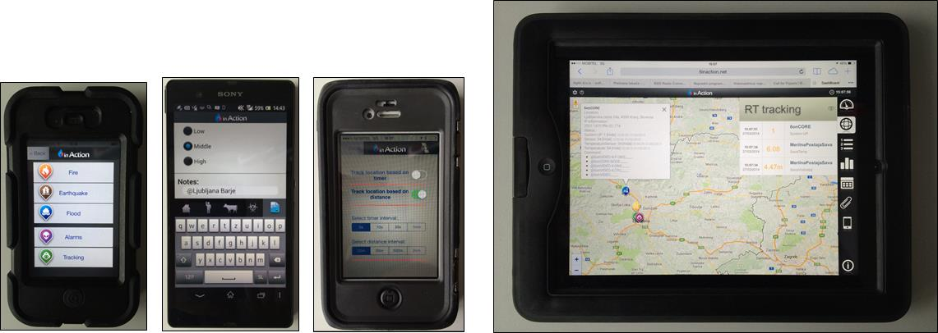
TACTICAL&MISSION SMART DEVICES AND APPS
COTS TERMINALS + IP67/MIL enclosure
Dust proof, water proof, drop/crash proof
INTEGRATING CUSTOM TACTICAL AND IT APPS
Tracking, contextualized on-site triage, live video streaming
Mail, file share, video, picture, cloud apps
IPv6 PDP Context / EPS bearer support?
Android:
iOS:
☑☑✖✖
✖✖✖✖

Slide 22
IoT-Driven Intervention Management

Slide 23
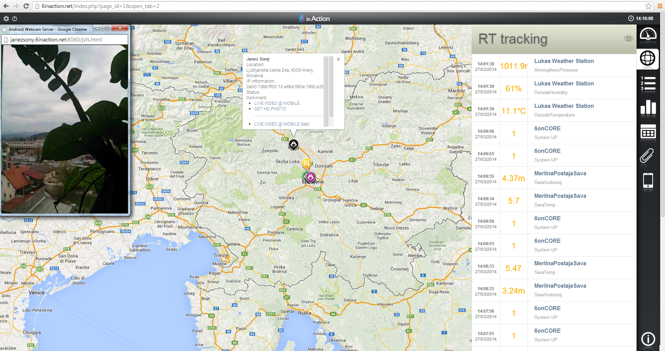
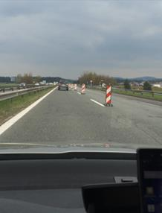
IoT-DRIVEN INTERVENTION MANAGEMENT
Real-time common operational picture
Mash up of sensor and user events, live unit tracking, live video streaming and remotely captured on-site high resolution pictures
LIVE VIDEO
STREAMING
LIVE UNIT
TRACKING
RT-SENSOR AND USER
EVENTS

Slide 24
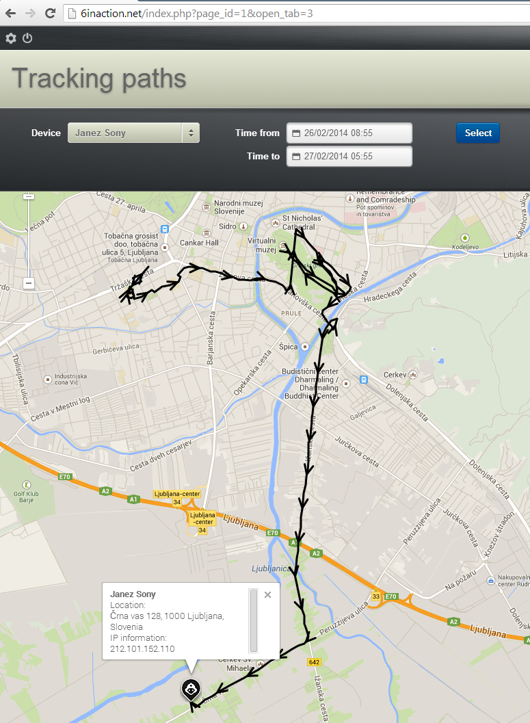
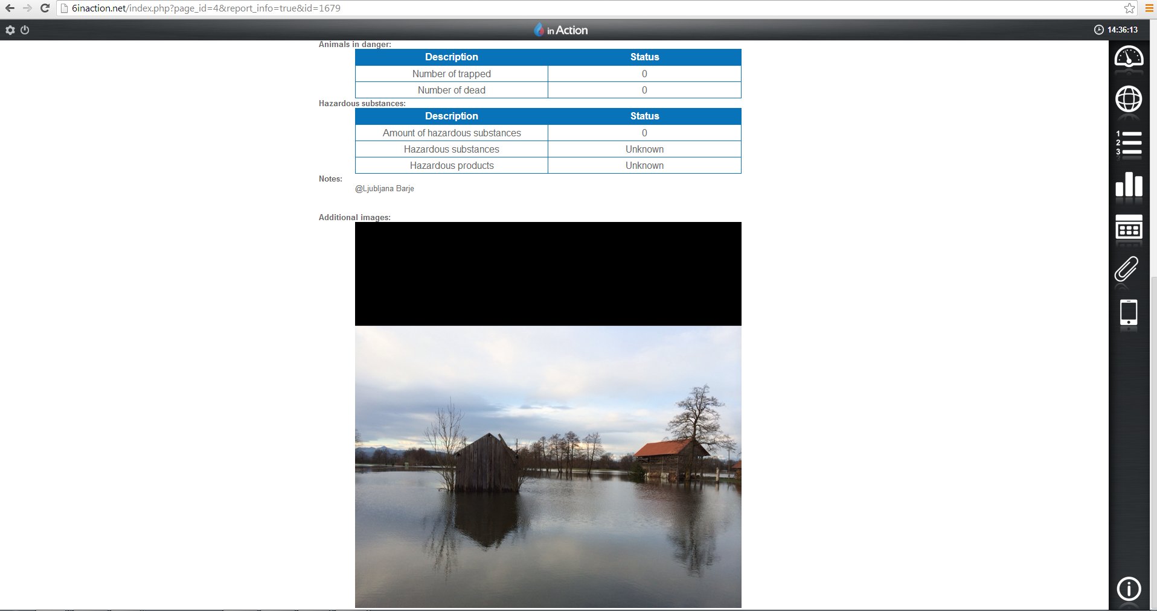
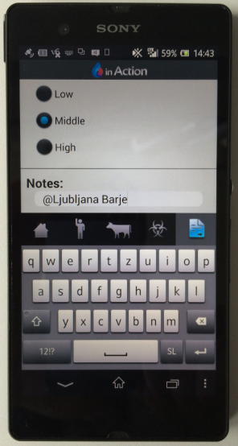
IoT-DRIVEN INTERVENTION MANAGEMENT
Contextualized real-time triage reporting
User notes + site map + on-site captured high resolution picture + unit track

Slide 25
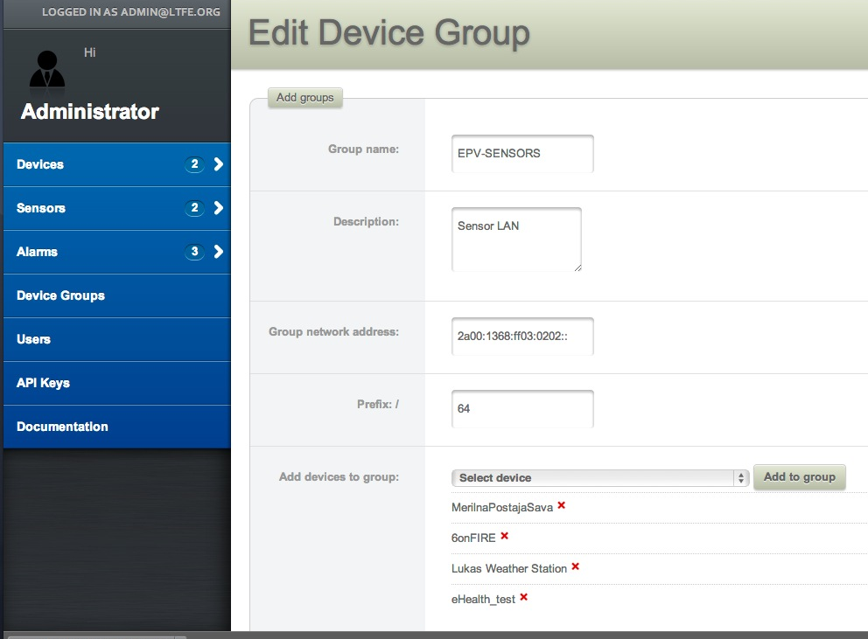
Smart IoT Management – Hierarchical IPv6 Addressing (proposal!)
NATIONAL L./32
Municipals
Areas
Units
Segments
MOL (2a00:1368:ff::/40)
256 Areas
256
Municipalities
Mobile Users (2a00:1368:ff00::/48)
GBL /48 (2a00:1368:ff01::/48)
OZRCO /48 (2a00:1368:ff02::/48)
EPV /48 (2a00:1368:ff03::/48)
EPV1 /56
256 Units
EPV2 /56 (2a00:1368:ff03:02::/56)
LAN1 /64 (2a00:1368:ff03:0201/64)
256 Segments
Sensor LAN2 /64 (2a00:1368:ff03:0202/64)

Slide 26
System piloting and testing

Slide 27
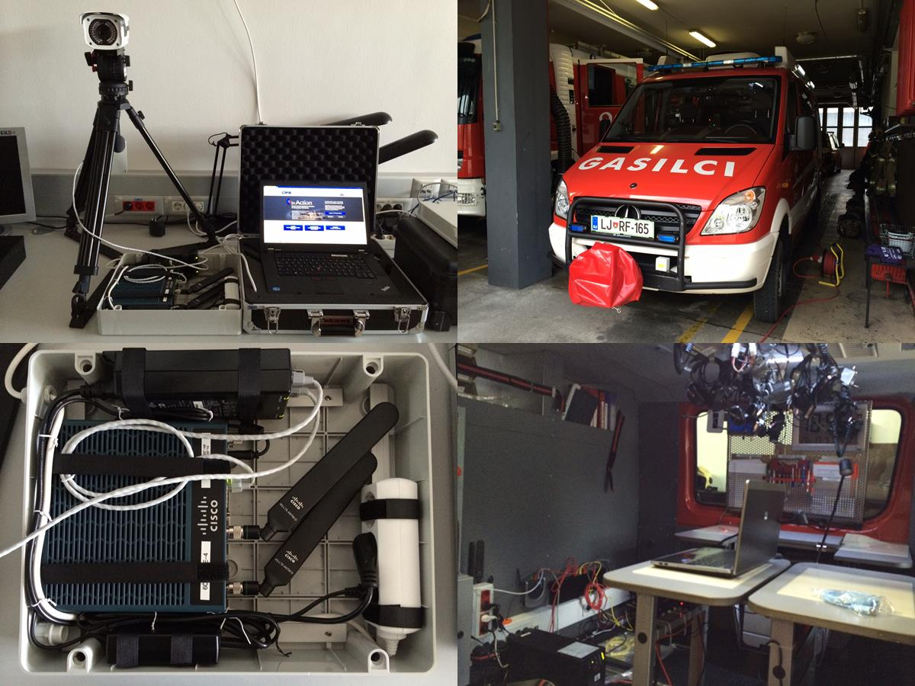
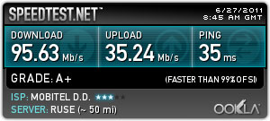

Slide 28
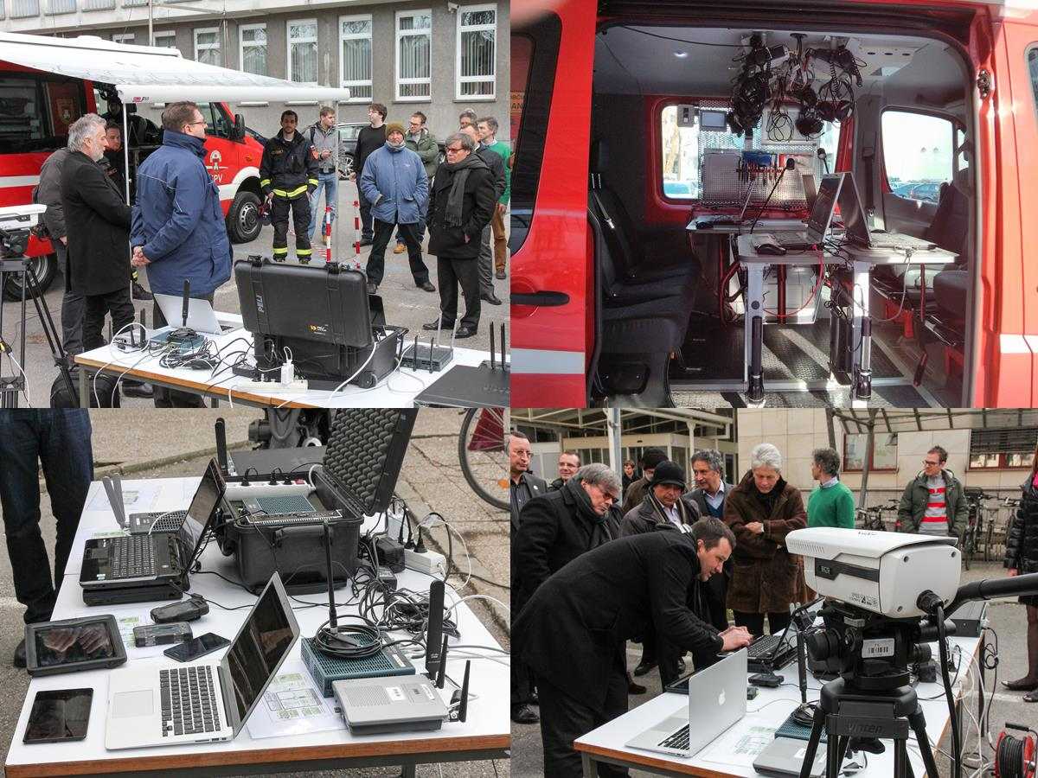

Slide 29
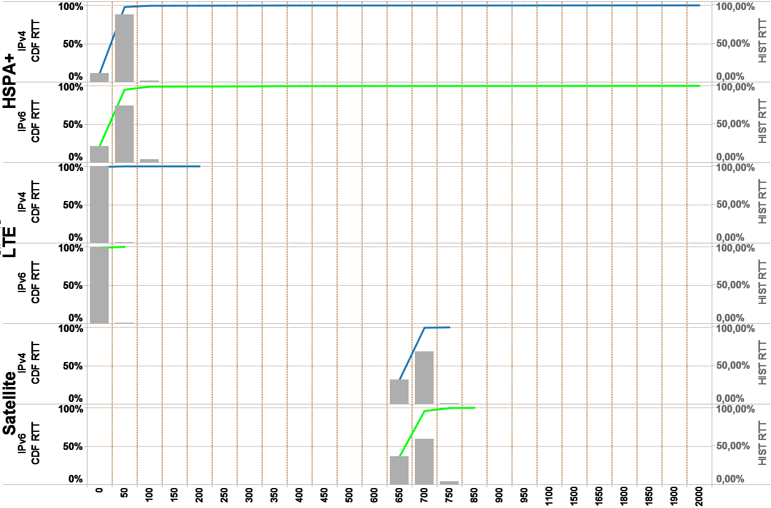
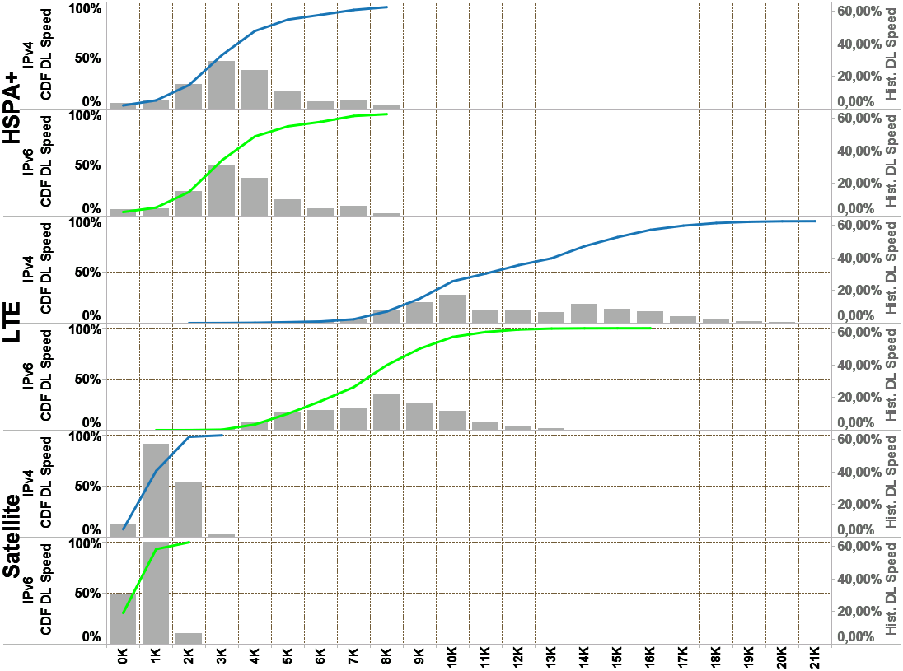
System performance measurements: results for densely populated city area
RTT delay [ms]
DL Speed [Kbit/s]
- CDF (line) and histogram (bar) graph
- Blue line (IPv4) and green line (IPv6)

Slide 30
Conclusion – IPv6&LTE for public safety?
Pros: “All IP” proven commercial technologies
High mobile performance
up to 95 Mbps and 10 ms data plane RTT (using LTE)
3G/4G bullet proof system integrated security
AKA authentication, AES/3G SNOW user and control plane encryption
Extended authentication (i.e. RADIUS) for central user control and provisioning
For the most critical services, additional IPSec, SSL VPN and HTTPS security services
Standardized QoS support
System virtualization: business APNs, MVNO, national roaming
Standardized interfaces: various networking and handheld equipment vendors/providers
Open and powerful ecosystem for service (multimedia, sensors, M2M) development
Easy integration between custom services and existent IT services
Easy cross-border and international on-site cooperation
based on international roaming (GRX/IPX)
Cons: immature technologies in mission critical situations
3GPP public safety standardization not finished, missing “TETRA like” features
BB PPDR frequency band is in a process of EU allocation
Missing IPv6 support on “some” mobiles/tablets
Missing added value features on routing gear (i.e. NEMOv6 McA) ?
Millions invested in TETRA

Slide 31






Lead by ULFE, official GEN6 partner
Powered by partners
Go6 Institute – federating and consultancy role,
Ministry of Education, Science and Sport – integration of project in Slovenian government,
Water Institute - Pilot system requirements and pilot testing,
Municipality of Ljubljana (MOL), Department for Protection, Rescue and Civil Defense (OZRCO) – pilot system requirements and pilot testing, live emergency response environment & infrastructure,
Telekom Slovenije, d. d. – fixed and mobile network provider
Cisco System Slovenia&Global – networking equipment support.
Academic and Research Network of Slovenia (ARNES)

Slide 32


