Slide 1

Gathering and Processing Energy Consumption Data from Greek Schools over IPv6
Emmanouel (Manos) Varvarigos
Computer Technology Institute and Press "Diophantus“, CTI
Greece

Slide 2




IPv6 Pilot in Greece: “Energy Efficiency in School Networks with IPv6“
Objectives
Use IPv6 as a service enabler
Raise energy awareness
Engage school communities

Slide 3





IPv6 Pilot in Greece: “Energy Efficiency in School Networks with IPv6“
Pilot
The pilot provides real-time energy efficiency services over IPv6-enabled networks to the local educational community
Energy data are recorded using IPv6 enabled devices attached to smart meters
Data are transferred over dual stack (IPv4 and IPv6) networks
Energy data are being aggregated, processed structured and transformed.
Web portal presents real time energy consumption data and statistics
50 schools , 11500 students

Slide 4
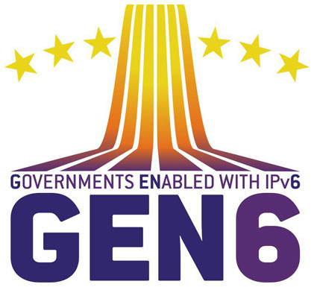



IPv6 Pilot in Greece: “Energy Efficiency in School Networks with IPv6“
Pilot’s Partners
IPv6 networks
The Greek Research & Technology Network (GRNET), responsible for providing networking and cloud computing services to the Greek academic and research communities
energy metering
portal
analytics
school communities
The Intelen Group, a start-up company providing services to the Energy and ICT sector, such as smart metering, meter data management
The Computer Technology Institute & Press “Diophantus” (CTI), responsible for the administration and the daily operation of the Greek School Network
educational methods

Slide 5
IPv6 Pilot in Greece “Energy Efficiency in School Networks with IPv6“
Technical Description

Slide 6
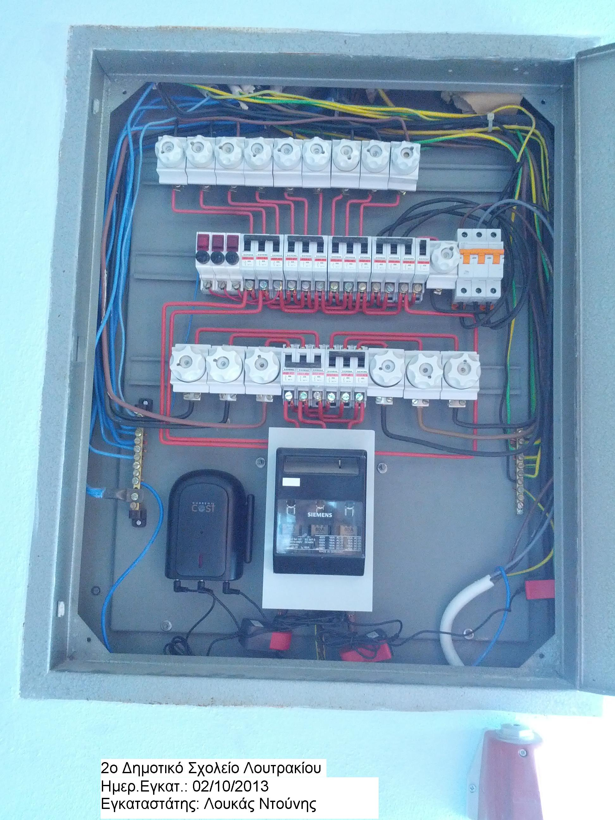
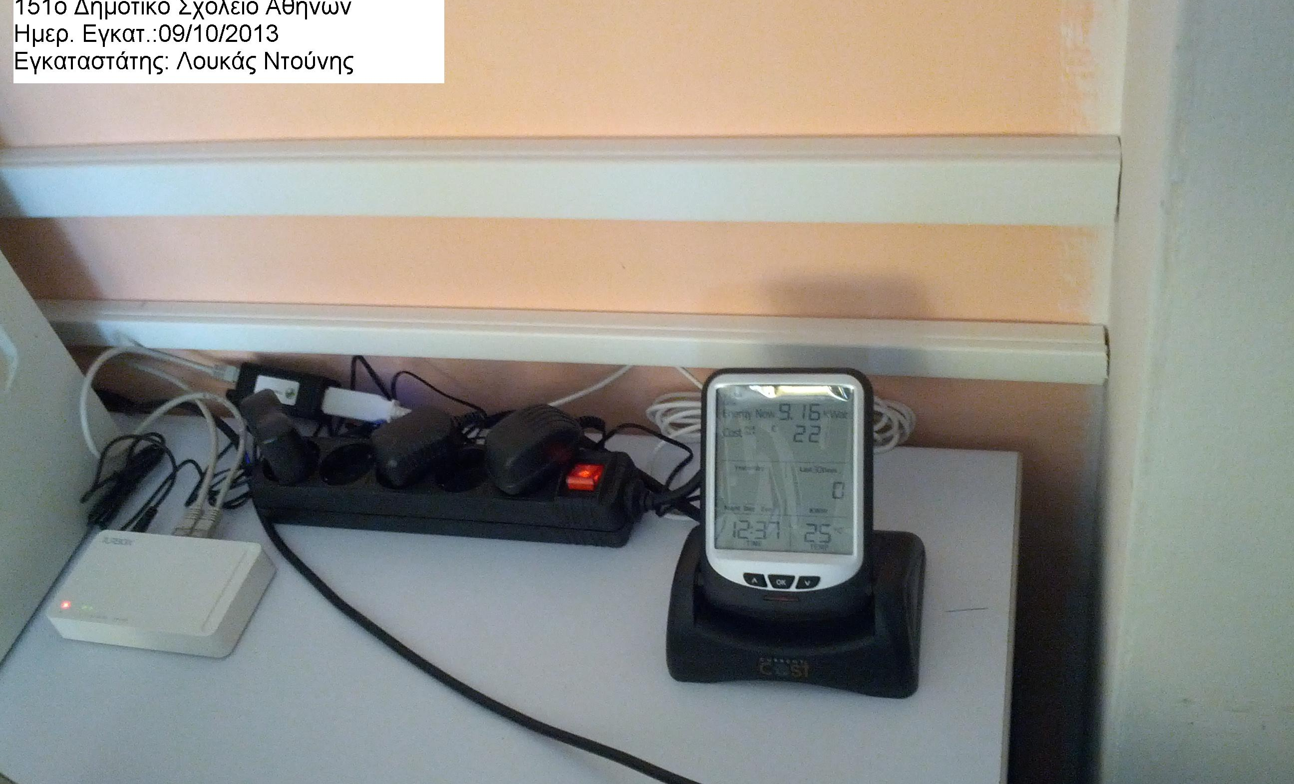
IPv6 Pilot in Greece “Energy Efficiency in School Networks with IPv6“
Energy Metering
The smart metering infrastructure consists of a consumption metering device and the i-box
The i-box is a network device that acts as a data bridge between the power meter and the school’s router
Both i-box and school router have IPv6 global address

Slide 7
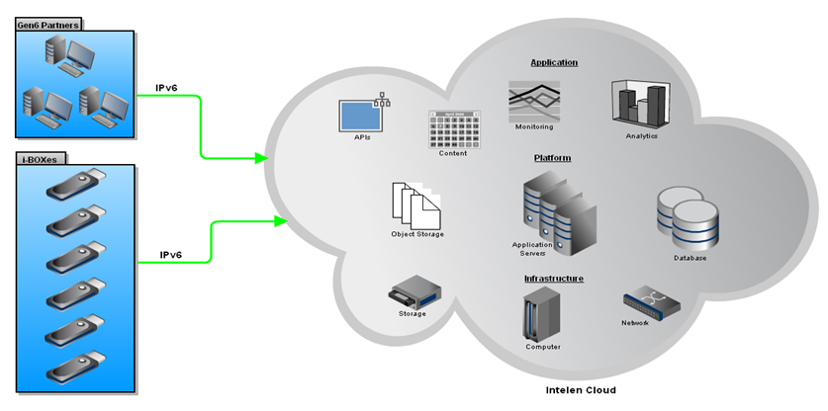
IPv6 Pilot in Greece “Energy Efficiency in School Networks with IPv6“
Energy Analytics
Energy Information System in the cloud
Energy data are being aggregated, structured and processed
Energy data are also correlated with other data (school area, student count, etc.)
Calculations and data mining algorithms are performed

Slide 8
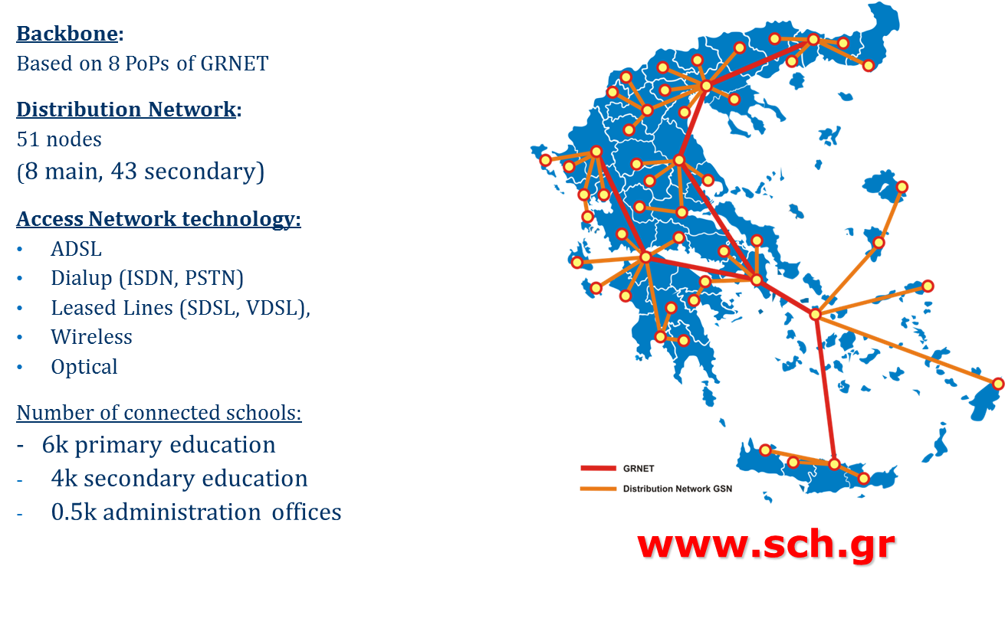
IPv6 Pilot in Greece “Energy Efficiency in School Networks with IPv6“
Networking Infrastructure

Slide 9
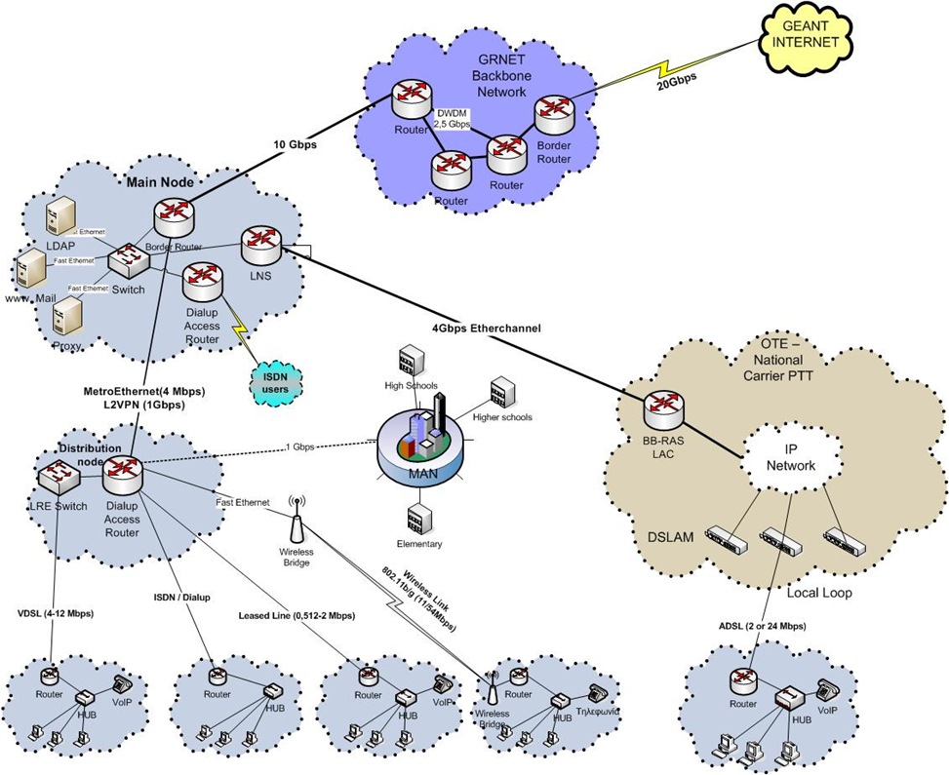
IPv6 Pilot in Greece “Energy Efficiency in School Networks with IPv6“
Networking Infrastructure
The GRNET backbone & GSN distribution networks are dual stack i.e. supporting both IPv4 and IPv6
On the access network, IPv6 has also been enabled for 95% of GSN users

Slide 10
IPv6 Pilot in Greece “Energy Efficiency in School Networks with IPv6“
Networking Infrastructure
In GSN one /47 address space is assigned to the access network and one /48 is assigned the to backbone network
It will be fully revised in the near future, to fulfill the needs of the school networks
OSPFv3 has been selected as a routing protocol for IPv6 interconnection within the GSN
Security rules for incoming and outgoing traffic have been expanded to cover IPv6 traffic in order to prohibit/avoid specific content, e.g. content related to gambling, hate talk, etc, to be delivered to pupils

Slide 11
IPv6 Pilot in Greece “Energy Efficiency in School Networks with IPv6“
Networking Infrastructure
Benefits of IPv6 / problems with IPv4
IPv6 removes the limitations imposed by the IPv4 address shortage
Every school has a ΝΑΤ / PAT gateway due to address shortage
Difficult to debug interconnection problems
IPv6: Enough address space for every school and pupil!
P2P applications do not work with servers behind PAT
Multimedia e-learning and peer-to-peer virtual collaboration applications
IPv6: Easier P2P application development

Slide 12
IPv6 Pilot in Greece “Energy Efficiency in School Networks with IPv6“
Networking Infrastructure
Benefits of IPv6 / problems with IPv4
Management and security issues
Deployment procedures in large numbers (auto-configuration of CPE routers and PCs)
Address fragmentation resolved
Easier aggregation of classes of users
Security (based on ACLs) simplified using the IPv6 addressing schema
Innovation – Expose to new technologies
Today’s school pupils are the future engineers
IPv6 allows the development of new advanced services that exploit features unique to IPv6 environments, such as enhanced security, multicast or mobility, QoS, etc
Multiply the impact of other IPv6-enabled networks in Greece

Slide 13
IPv6 Pilot in Greece “Energy Efficiency in School Networks with IPv6“
GSN Services
Update services to support IPv6
Email (SMTP, IMAP, POP3)
Web hosting
GSN Web portal (www.sch.gr)
Web proxy / web filtering
AAA (Radius software and attributes)
Instant Messaging
Directory service (LDAP)
DNS

Slide 14
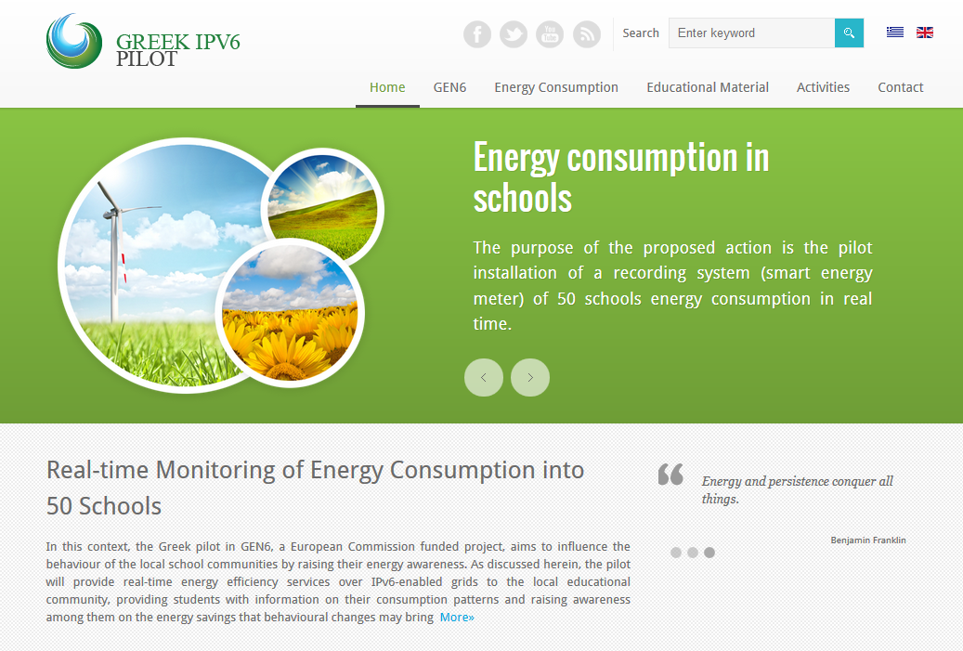
IPv6 Pilot in Greece “Energy Efficiency in School Networks with IPv6“
Web Portal – gen6.cti.gr

Slide 15
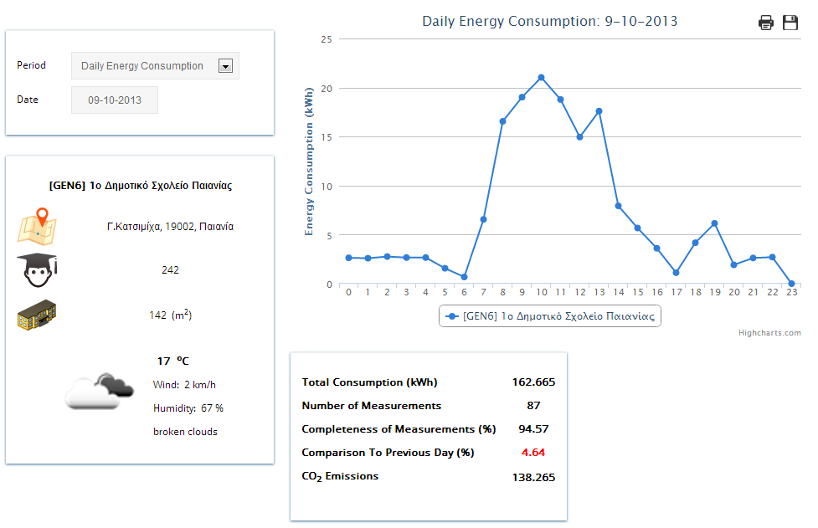
IPv6 Pilot in Greece “Energy Efficiency in School Networks with IPv6“
Web Portal – gen6.cti.gr

Slide 16

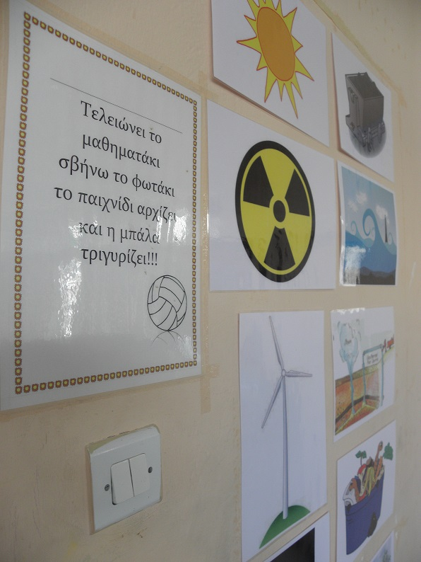
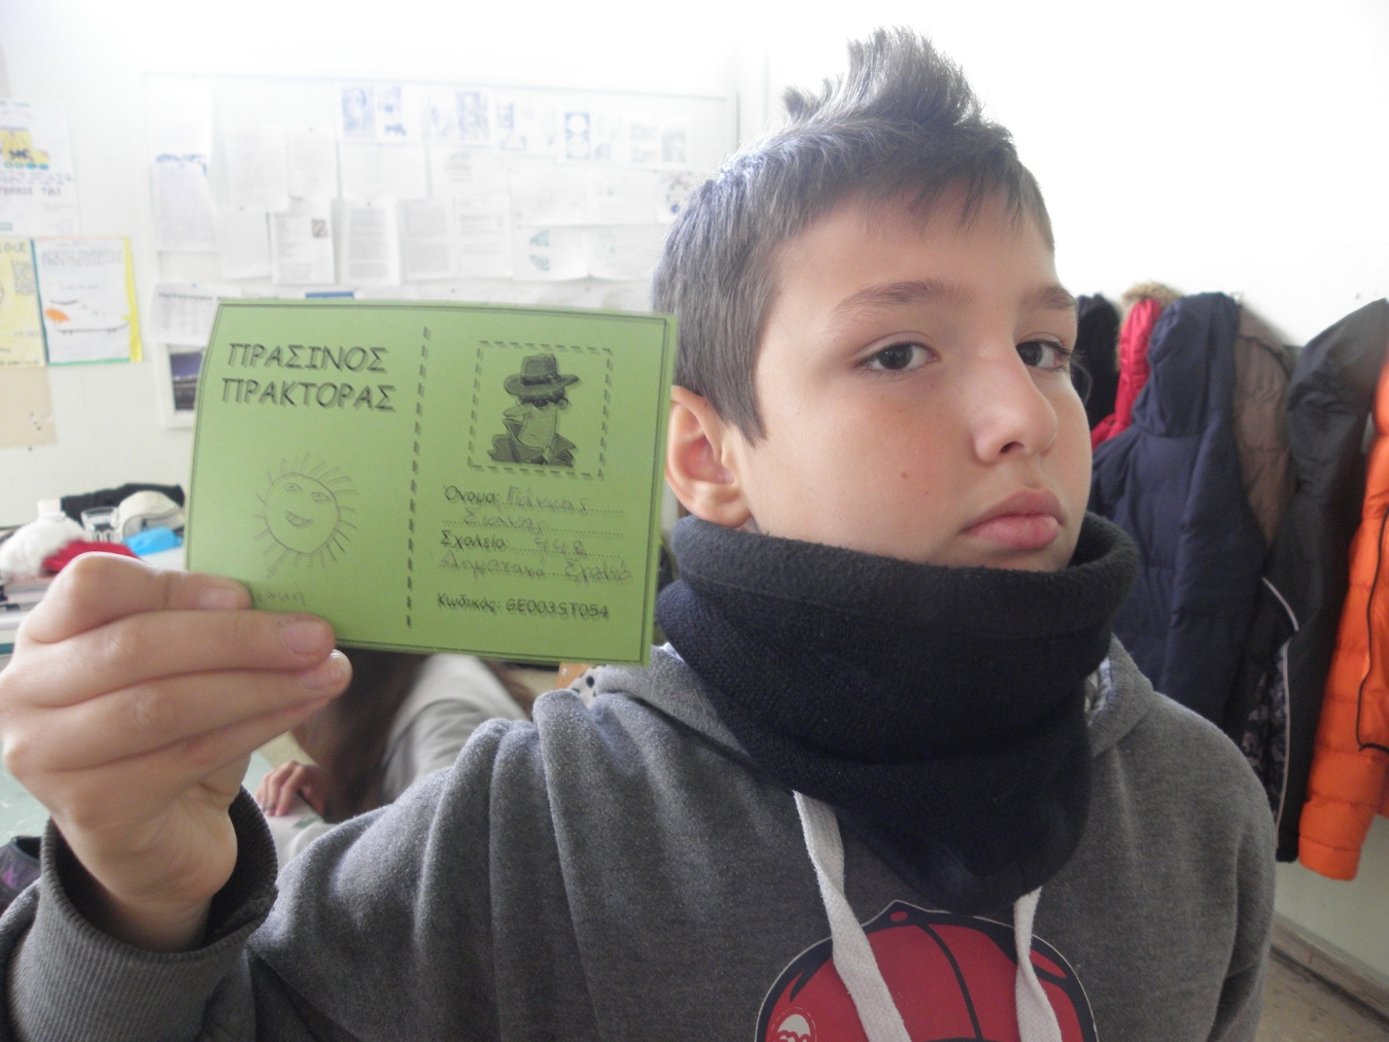

IPv6 Pilot in Greece “Energy Efficiency in School Networks with IPv6“
Current status
Completion of installations in 50 schools in Attica, Achaia, Corinthia
Collection of energy consumption data over IPv6 from the existing systems
Dissemination activities in schools
Install other kinds of sensors (e.g., weather related) to schools

Slide 17
IPv6 Pilot in Greece “Energy Efficiency in School Networks with IPv6“
Experience gained
IPv6 deployment
Locate and diagnose possible escalation problems
Gain technical experience and become familiar with IPv6
Helpful if IPv6 deployment coincides with equipment upgrade
Learned and in some way proved that:
IPv6 deployment in a large and complicated network is achievable with reasonable cost (in terms of equipment and man power)
IPv6 technology is mature
There are no impacts on IPv4 services
Gained technical experience in IPv6 allowing to make the IPv6 implementation complete and universal

Slide 18
IPv6 Pilot in Greece “Energy Efficiency in School Networks with IPv6“
Conclusions
IPv6 can become an enabling technology
IPv6 in support of Sensor grids
Higher Security
Easier interoperability and fast installation
Bi-directional communication
IPv6 in support of IoT
Bigger address space, everything connected
Point-to-point control and access tunneling to real time data
Energy Efficiency in Schools pilot has a huge impact
50 Greek Schools, with about 11500 students !!!
Inform the student communities in real time
how much energy is consumed by their actions
Change students’ behavior towards environmental protection
Reduce energy consumption

Slide 19
IPv6 Pilot in Greece “Energy Efficiency in School Networks with IPv6“
Thank you!
Emmanouel (Manos) Varvarigos
manos@ceid.upatras.gr
www.gen6-project.eu
gen6.cti.gr
www.cti.gr/en

