Slide 1
IPv6-Kongress 2014
23 May 2014
Cinestar Metropolis, Frankfurt, Germany
An I.P.V. SixXS Overview
Jeroen Massar, SixXS
jeroen@sixxs.net
IPv6 Golden Networks

Slide 2
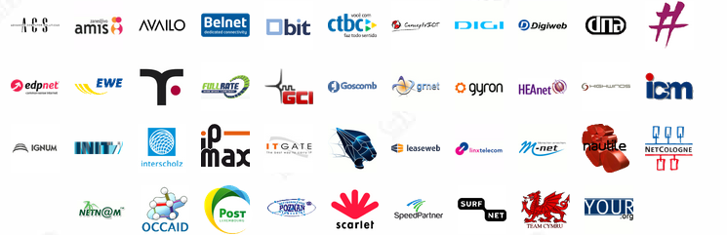
SixXS
SixXS is a small hobby project, grown a bit big, that provides a service for ISPs for a quick way of enabling their user base with IPv6.
Thanks to all the ISPs who are providing the PoPs, as without them it would not be possible to do this!

Slide 3


Just the two of us…
Jeroen Massar
Day-to-day running, SixXS v1, v2+ design,
sixxsd, frontend, PuTTY, ecmh, *
Btw, my first IPv6 prefix was 5f04:4f00:c0xx::something courtesy of SURFnet (RFC1897).
The remote tunnel endpoint used was zesbot.ipv6.surfnet.nl which is still alive today.
Work: Massar Networking
Pim van Pelt
Original IPng.nl project, SixXS v1 design,
policy, more PoPs, whiskey!
Work: Google

Slide 4
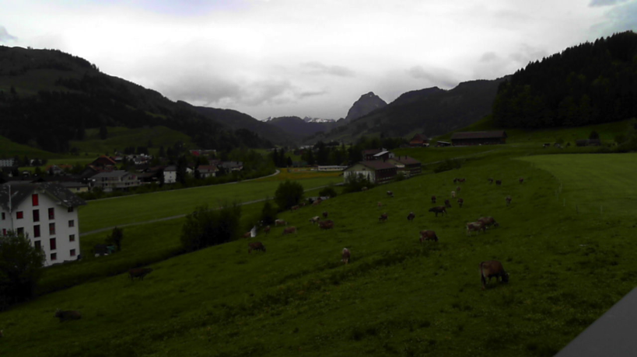
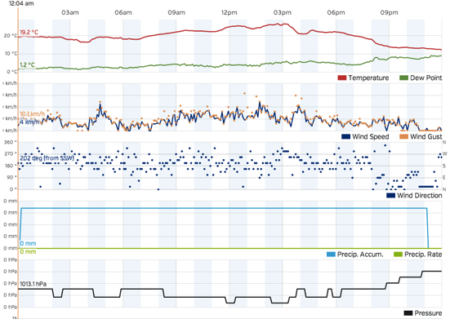
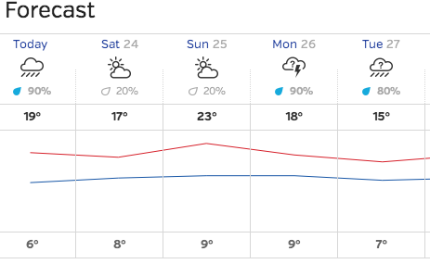
Why SixXS?
Didn’t have a static IPv4 address at home, didn’t have an IPv4 prefix either, everything behind NAT.
IPv6 gave access from other locations with (tunneled) IPv6 to home (which had a tunnel).
Can play IPv6Quake with friends without NAT issues.
Watch the cows on the home cam. (RPi with a USB webcam on IPv6)
Check the weather at home.

Slide 5
Short History (1/1)
2000: Started in as IPng.nl with 1 PoP in Amsterdam.
2002: Became SixXS as we provided the service for multiple ISPs, GRH launched.
2003: Heartbeat, TIC, IPv6Gate.
2004: AICCU, IPv4Gate.
2005: USA, GRH Distributed Traceroute.
2006: AYIYA support, 6bone shutdown.
2007: New Zealand, Wiki, BitTorrent Tracker.
2008: IPv6 DNS Glue, DNSSEC, 10k+ users
https://www.sixxs.net/news/

Slide 6
Short History (2/2)
2009: -SIXXS handles, NTP service, Google-over-IPv6
2010: Brazil!, per-tunnel TIC password
2011: Alaska, Czech Republic, Greece, Hungary, New Caledonia, Russia + sixxsd v4 beta
2012: sixxsd v4 everywhere, Vietnam, Live Tunnel Status, 10 years SixXS
2013: 35k active users, TIC STARTTLS, real SSL cert
2014: maybe finally new AICCU? ☺

Slide 7
RFC3053 – IPv6 Tunnel Broker
Tunnel Broker
config
PoP
IPv6 router
IPv4 router
server
you

Slide 8
Protocol 41
Protocol 41 = IPv6
It specifies how to put an IPv6 packet inside IPv4.
Protocol 41 is static only.
Protocol 41 doesn’t cross NATs.
https://www.sixxs.net/faq/connectivity/?faq=comparison

Slide 9
SixXS Tunnel Broker
Tunnel Broker
config
PoP
stats
IPv6 router
TIC
IPv4 router or NAT
server
you

Slide 10
Heartbeat
Dynamic/non-24/7 IPv4 endpoints.
Proto-41 is static. The moment the user unplugs, another user can get that IPv4 address. That user then gets proto-41 packets and the firewall tool beeps with warnings, which sometimes results in abuse reports because we are attacking them.
Allows one to move around proto-41 tunnels automatically or enable/disable them on the fly.

Slide 11
AYIYA – Anything in Anything
Proto-41 tunnels can’t cross NATs.
Proto-41 tunnels are not authenticated.
(read: one can spoof them easily)
Heartbeat runs next-to the proto-41 tunnel. Heartbeat might work, proto-41 might not.
AYIYA solves these issues by tunneling IPv6
inside IPv4/UDP and signing these packets.

Slide 12
AICCU
Automatic IPv6 Connectivity Client Utility
Proto-41, heartbeat and AYIYA tunnels.
Simple “Test” mode for diagnosing common issues, testing at least that the basics work (or not).
Windows, Linux, *BSD, OSX, AIX, Solaris, etc
Still in the pipeline:
Comprehensive “test” mode.
GUI/Web-interface for all platforms.

Slide 13
CPEs / Mobiles
AVM Fritz!Box has native heartbeat support.
Heartbeat support per TCL on Cisco.
Various vendors (Draytek, ZyXEL, Motorola, etc) include AICCU out-of-the-box with a little UI interface to configure it.
Most Linux-ish distributions have it (DD-WRT, Debians, Redhats etc)
Two Android apps: IPv6Droid + Androiccu.
(IOS VPN API is only available under NDA… hence no support there yet)
AYIYA is great for mobile devices (laptop/phone)

Slide 14
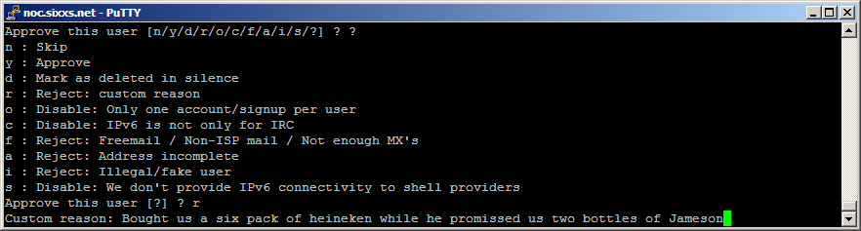
Reviewing
All requests are reviewed by humans (read: me).
As most faulty requests have similar things wrong we have a standard list of rejections, thus don’t be offended when you get rejected, it is not only you…
We reject in hope to receive clarification from the user why something looks odd.

Slide 15
Abuse and ISK
We require proper details, as effectively we become the IPv6 ISP for the user.
We need these for abuse handling.
People are less inclined to do bad things when their details are known -> kept SixXS possible!
ISK is our Credit system, it keeps people interested in keeping their tunnel up, and it avoids people who are ‘bad’ from wasting resources.
We once accepted XING/LinkedIN for bonus credit allowing getting a /48 subnet, useful when using a router (eg Fritz!Box). We do not anymore as default subnets exist to solve that problem.

Slide 16
The SixXS Daemon
Linux/*BSD kernels not made for 2k+ interfaces (tunnels), both randomly lost routes and even tunnel interfaces or endpoints.
sixxsd has a single ‘tun’ interface, we route /40s into that (yup, 5x /40s on deham01 + dedus01 go into it ;)
Handles tunnel encap/decap for proto-41 & AYIYA.
Lookup of tunnels without tree: we know the IPv6 address and structure
Handles stats (traffic count, latency test etc)
Tunnel prefix + 0x8000 = default routed subnet
https://www.sixxs.net/faq/sixxs/?faq=sixxsd

Slide 17
Prefixes
Tunnel Prefix:
2001:db8:1000:0abc::/64
::1 = PoP, ::2 = you
Default Routed Subnet Prefix:
2001:db8:1000:8abc::/64
Routed towards 2001:db8:1234:0abc::2
Full Subnet
2001:db8:1234::/48
Routed towards 2001:db8:1234:0abc::2

Slide 18
IPv6Gate
Allows access to any IPv4 website over
IPv6 from IPv6-only hosts:
http://www.heise.de.sixxs.org
Also allows the reverse: IPv6-only site
from IPv4-only host:
http://www.kame.net.ipv4.sixxs.org
HTTP only; no automatic clients/torrents allowed
More details https://www.sixxs.net/tools/gateway/

Slide 19
RFC4193 - ULA
IPv6 ULA (Unique Local Address)
RFC4193 Registration
fd00::/8 ULA Locally Assigned.
It is Unique, but maybe not Unique enough as it has a chance that it is not.
fc00::/8 ULA “Registered” – not specified
and thus can’t be used.
Nearly 200 registrations
Of course not guaranteed, when people don’t check this list it can’t be.
https://www.sixxs.net/tools/grh/ula/

Slide 20
GRH – Ghost Route Hunter
Peers actively with over 150 ISPs around the world.
A tool for detecting and hunting down Ghost Routes in the IPv6 routing tables and displaying DFP availability.
Distributed Looking Glass
Missing Prefixes
Prefix Comparison
https://www.sixxs.net/tools/grh/ula/

Slide 21
Future / Wish list
More Multicast
Need to integrate ecmh into sixxsd
AYIYA/DNS, AYIYA/HTTP(S), AYIYA/crypted
New AICCU client
Need time to finalize / properly test
Fix DNSSEC support
BGP Support / Multi-PoP Tunnels
Updated signup procedure
User-Detail-changing through website
http://www.sixxs.net/about/technology/

Slide 22
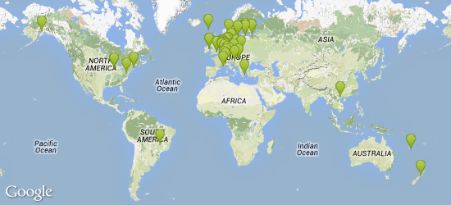
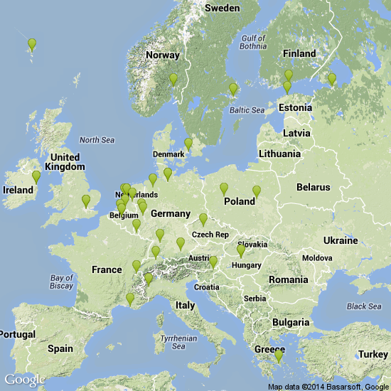
The Numbers
44 PoPs in 28 countries (be,br,cz,dk,ee,fo,fi,fr,de,gr, hu,ie,it,lu,nl,nc,nz,no,pl,ru,si, se,ch,uk,us,vn)
41k+ active users (35% .de)
42k+ active tunnels
(10k static, 12k heartbeat, 20k AYIYA)
13k+ /48 subnets
1 Gbit/s avg traffic
2 Gbit/s peak traffic
https://www.sixxs.net/pops/
https://www.sixxs.net/misc/usage/
https://www.sixxs.net/misc/traffic/

Slide 23
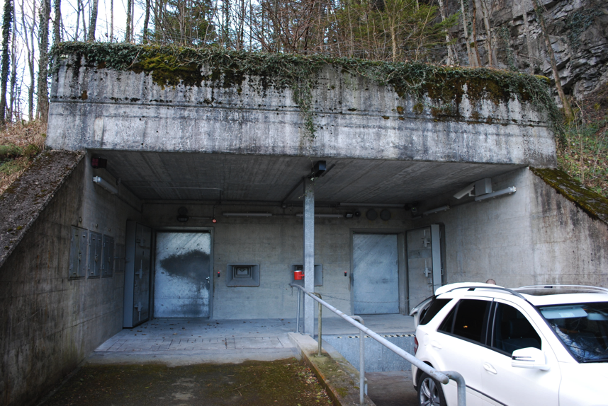
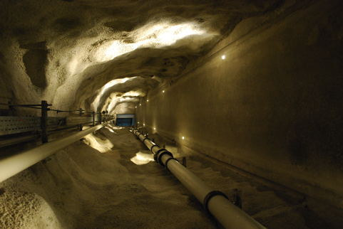
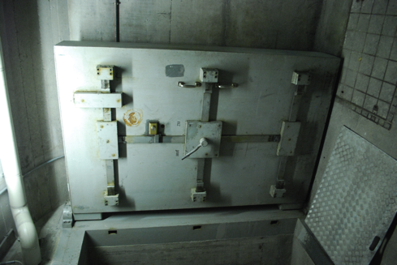
One last thing…
Thanks Concepts ICT, now part of KPN, for hosting the central SixXS systems for twelve years!
For security and safety, these functions are now hosted on our own, Pim+Jeroen’s, hardware in a redundant system & network inside Deltalis’s datacenter-bunker. With many thanks to Deltalis and IP-Max for having us there.

Slide 24
Questions?
Jeroen Massar
JRM1-RIPE
http://www.sixxs.net/
jeroen@sixxs.net

